Slide 1
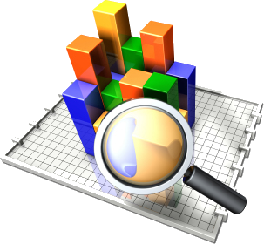
DATA 1203 – Business Analysis & ASSESSMENTS
Assessment-2
Submitted by Navya S S
100806254
Under the guidance of Mr. Rick Lambroff

Slide 2
TOPICS TO DISCUSS
1. About Dataset
2. Power BI and Benefits
3. Alcohol Consumption explained
4. Data Manipulation in Python
5. Interactive lab
6. Conclusion
7. References

Slide 3
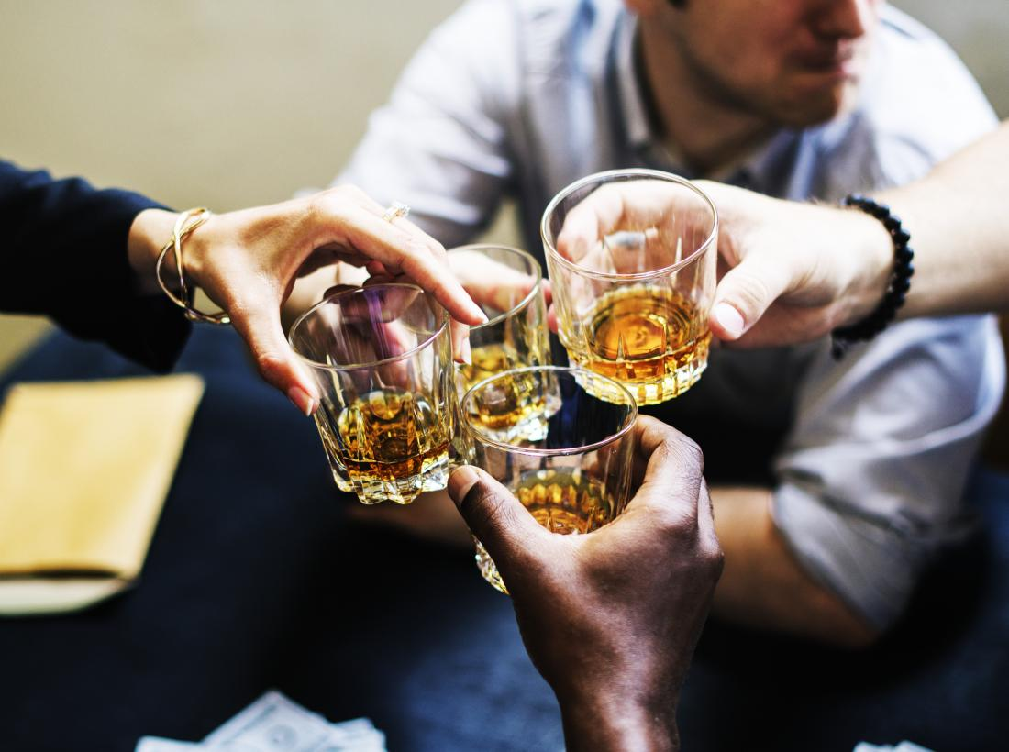
Alcohol Consumption Analysis By Region

Slide 4
The Goal is to turn data into information, and information into insight.
Carly Florina

Slide 5
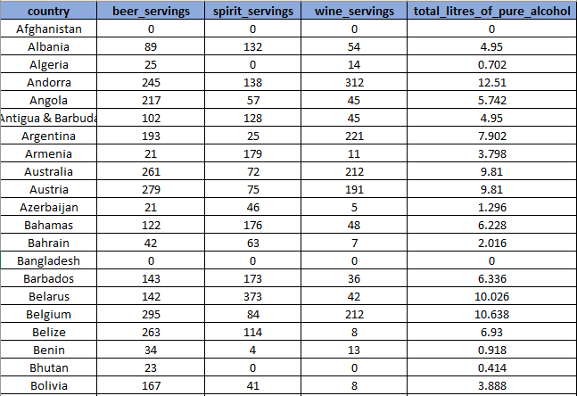
About the Data Set
The dataset has information about alcohol consumption in different countries.
It has 193 rows and 6 columns.
The dataset is taken from data world website.
5

Slide 6
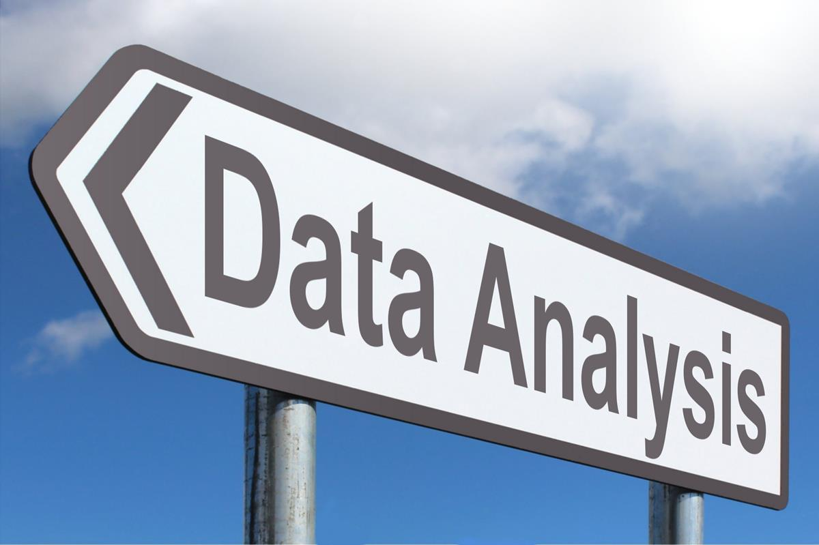
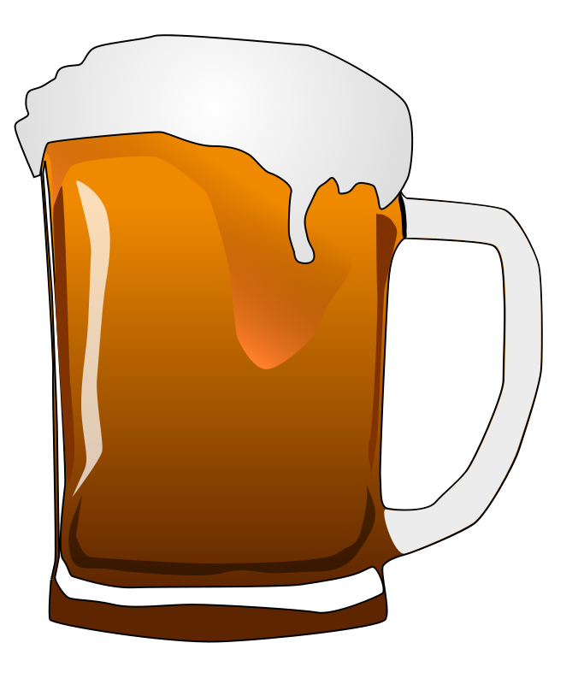
How is alcoholol consumption measured ?
Other studies using aggregate–level data have analyzed per capita alcohol consumption in various countries. These studies can be used to relate per capita consumption to certain alcohol–related outcomes and to evaluate changes of both consumption and different outcomes within a country or across countries over time.
Are there different drinking cultures in the world?
Throughout the world, numerous different drinking cultures and attitudes toward alcohol exist. A more theoretical literature, which is somewhat separate from research comparing actual survey rates of alcohol consumption across countries, has been devoted to describing these differing drinking cultures.
6

Slide 7
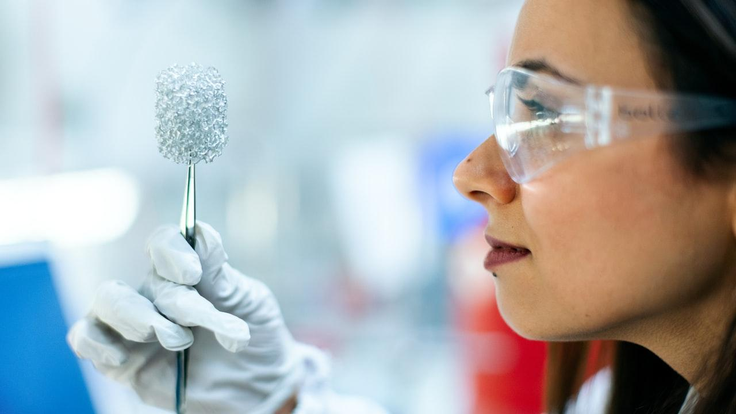
Data Manipulation in Python

Slide 8
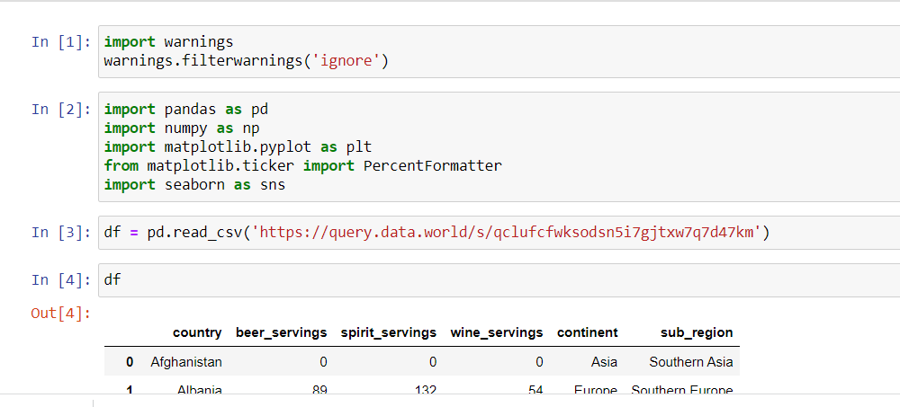
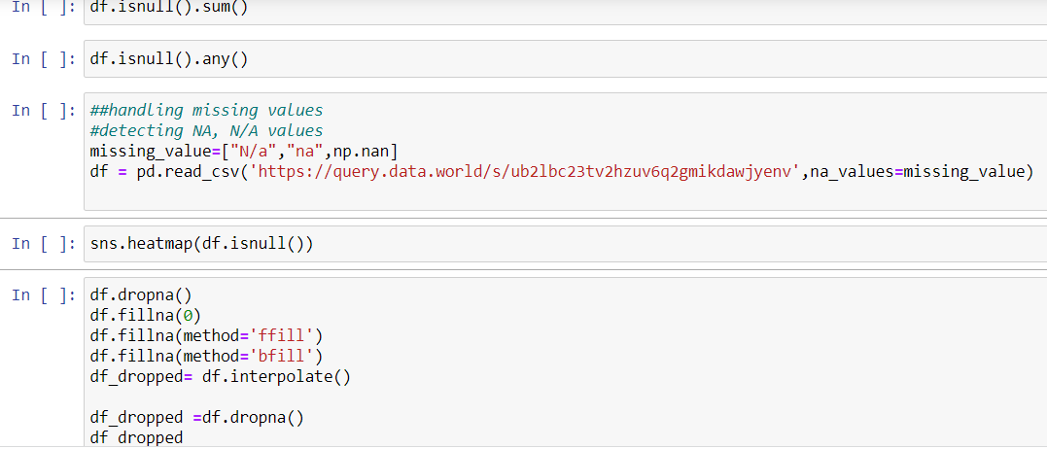
Data Extraction
Data Manipulation
8

Slide 9
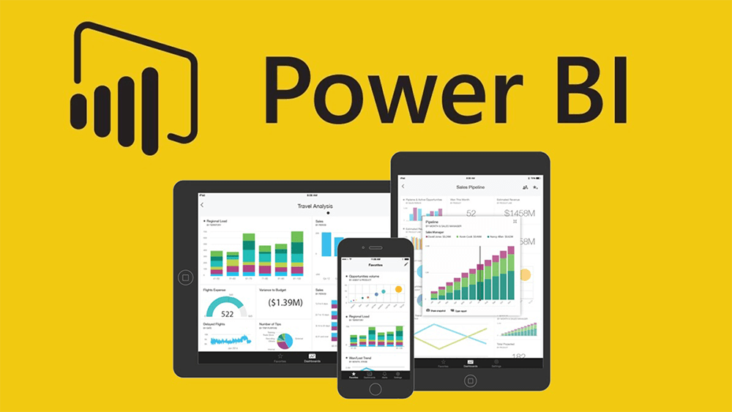
Power BI

Slide 10
What is Power BI
Power BI is a business analytics service by Microsoft. It aims to provide interactive visualizations and business intelligence capabilities with an interface simple enough for end users to create their own reports and dashboards.
Microsoft Power BI is a business intelligence platform that provides nontechnical business users with tools for aggregating, analyzing, visualizing and sharing data. Power BI's user interface is fairly intuitive for users familiar with excel and its deep integration with other Microsoft products makes it a very versatile self-service tool that requires little upfront training.
Benefits of BI
Minimal upfront costs
Personalized dashboards
View Power BI reports across multiple platforms and devices
Consolidate multiple data sources through Power BI
Easy implementation
Drag-and-drop functionality
Growing Power BI online community and many more

Slide 11
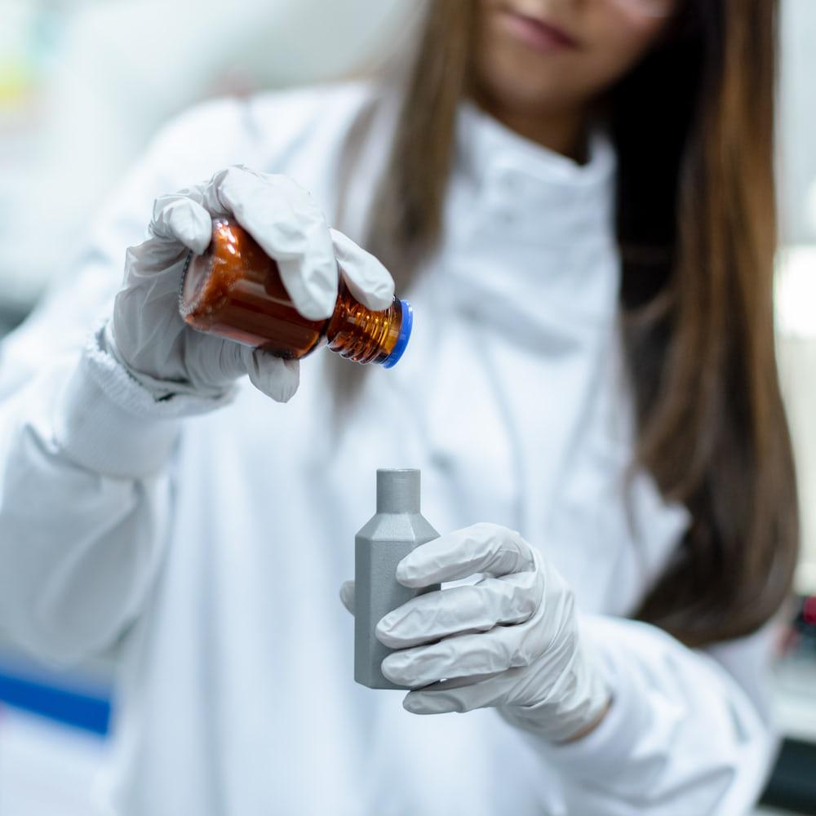
Risk Factors
Worldwide, 3 million deaths every year result from harmful use of alcohol, this represent 5.3 % of all deaths.
The harmful use of alcohol is a causal factor in more than 200 disease and injury conditions.
Overall, 5.1 % of the global burden of disease and injury is attributable to alcohol, as measured in disability-adjusted life years (DALYs).
Alcohol consumption causes death and disability relatively early in life. In the age group 20–39 years approximately 13.5 % of the total deaths are alcohol-attributable.
There is a causal relationship between harmful use of alcohol and a range of mental and behavioural disorders, other noncommunicable conditions as well as injuries.
The latest causal relationships have been established between harmful drinking and incidence of infectious diseases such as tuberculosis as well as the course of HIV/AIDS.
Beyond health consequences, the harmful use of alcohol brings significant social and economic losses to individuals and society at large.

Slide 12

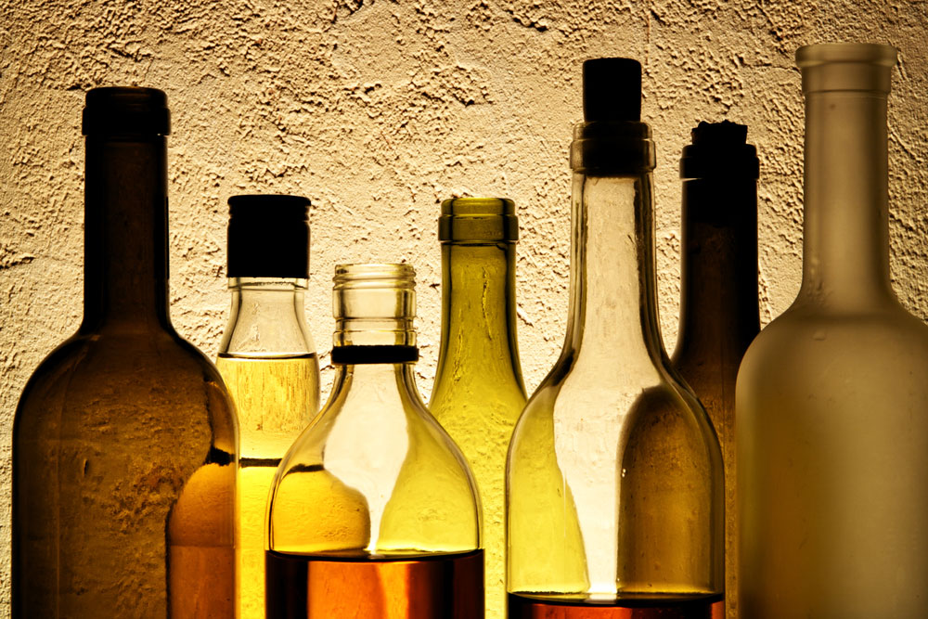


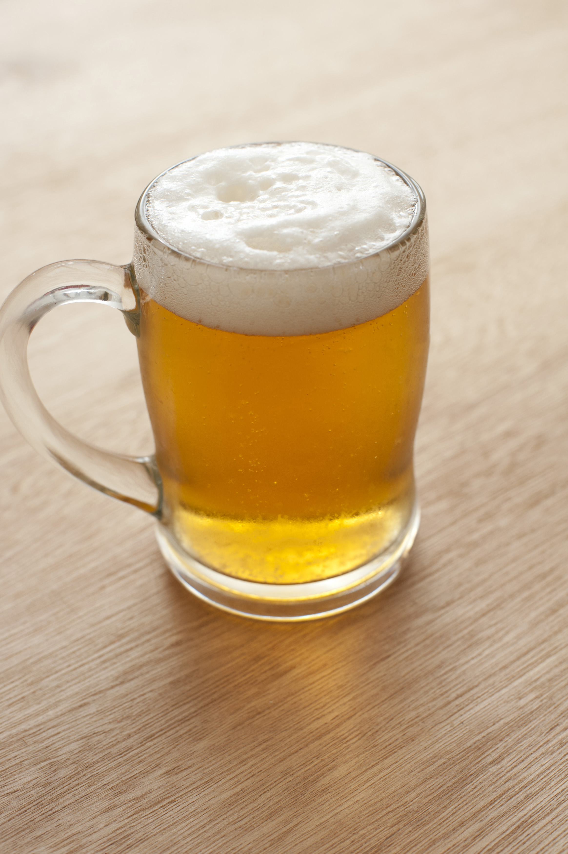
Classification of different alcoholic beverages
Different types of spirits
Whiskey.
Brandy.
GIN.
RUM.
VODKA.
Ale
Stout
Lambic
Porter
Lager
Classification of different alcoholic beverages
Wine
Beer
Spirits
Types of Wine
White Wine
Red Wine
Rose Wine
Dessert Wine
Marcos Galán JOB TITLE
Blue is the colour of the clear sky and the deep sea
12

Slide 13
Interactive Lab

Slide 14
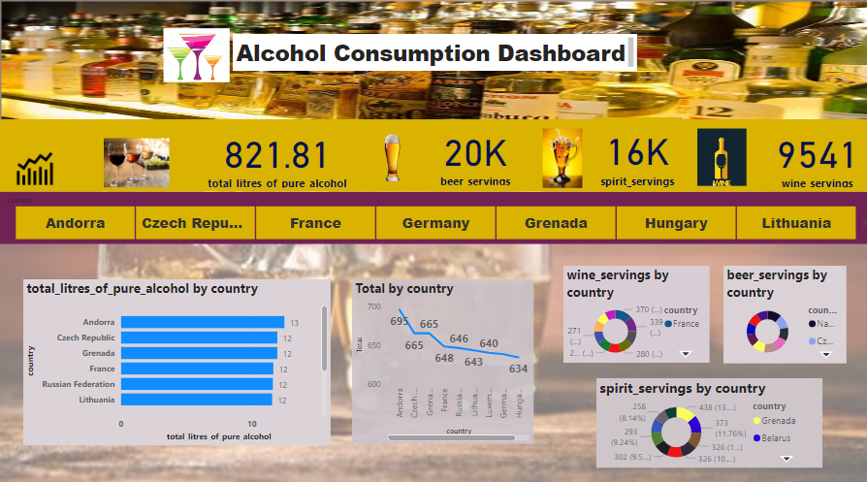
ALCOHOL CONSUMPTION DASHBOARD

Slide 15


Presentation Video Link
Presentation Video Link :
https://www.youtube.com/watch?v=6JsoTYks9ew

Slide 16
CONCLUSION
Andorra, Czech Republic, Creneda, France, Russian Federation are the top 5 countries with highest alcohol consumption.
821.81 litres of pure alcohol in all countries
So there are 20K beer servings in total across all countries, 16K and 9k spirits and Wine respectively.
Alcohol consumption can be reduced by regulating the marketing of alcoholic beverages
raising awareness of public health problems caused by harmful use of alcohol.

Slide 17
References:
Dataset:
https://query.data.world/s/a7uelpp7e3zxkxse6hrjp67m4jqm5n
Jupyter:
https://jupyter.org/install

Slide 18
THANKS !
Any questions?
You can find me at:
Navya.seermallannashanthkumar@dcmail.ca

